Slide 1
Medicaid Rate Updates
For Vaya Health Provider Advisory Council
Wednesday, January 17, 2024
Paul Tax
Data Analyst

Slide 3
Rate Update – General Information
In December 2023, Vaya Health announced Standard Rates changes effective for date of service Jan. 1, 2024 for select service and codes across the following Medicaid Benefit Plans: Medicaid 1915(b) Clinician and Non-Clinician; 1915(b)(3); 1915(i); and 1915(c) (Innovations). Select Medicaid (c) (Innovations) Rate Changes are also in the process of being applied retroactive to July 1, 2023.
Providers are responsible for ensuring that your billing systems are filing claims at or above the reimbursement rate in order to earn the full rate amount.
When the Vaya standard rate becomes higher than an existing / approved provider-specific or member-specific rate, the latter will be lapsed or end-dated so that the higher rate is the one being paid.
Today’s presentation provides some additional information on how and when Vaya will complete the retroactive payment process to support the Innovations Rate Changes for the period from July 1, 2023 to Dec. 31, 2023.

Slide 4
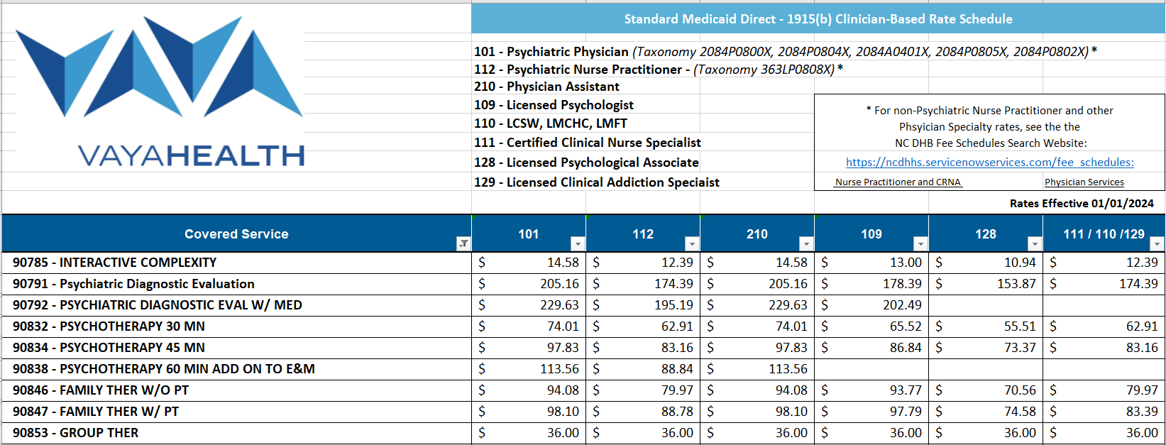
Rate Updates – 1915(b) Clinician
Sample of Codes and Rates Displayed Below. Full Schedule available online.
Note: New Psychiatric Physician and Psychiatric Nurse Practitioner License Group distinctions

Slide 5
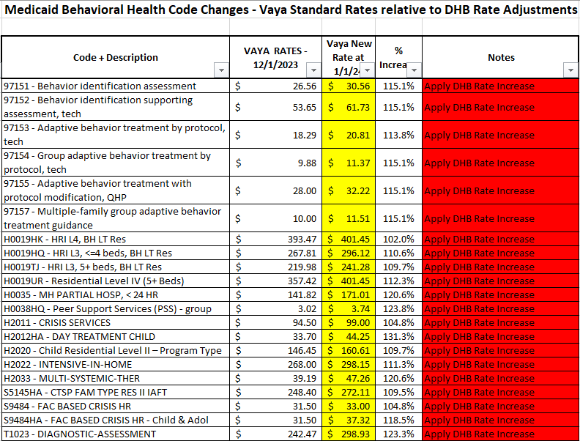
Rate Updates – 1915(b) Non-Clinician
Below is the list of Behavioral Health Code and Rate Changes effective Jan 1, 2024.

Slide 6
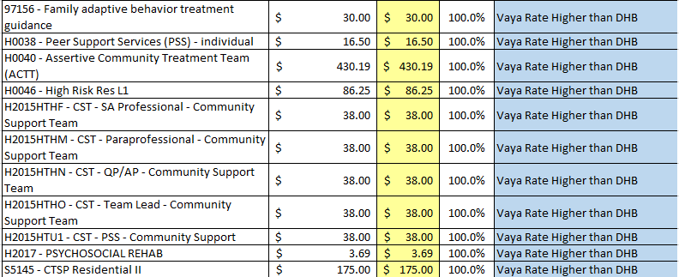
Rate Updates – 1915(b) Non-Clinician
These Behavioral Health Codes and Rates will remain the same, as Vaya’s Rate is higher than NC DHB.

Slide 7
Rate Updates – 1915(b)(3)
Impact of NC DHB Rate increases on 1915(b)(3) Services

Slide 8
Rate Updates – 1915(i)
Impact of NC DHB Rate increases on 1915(i) Services

Slide 9
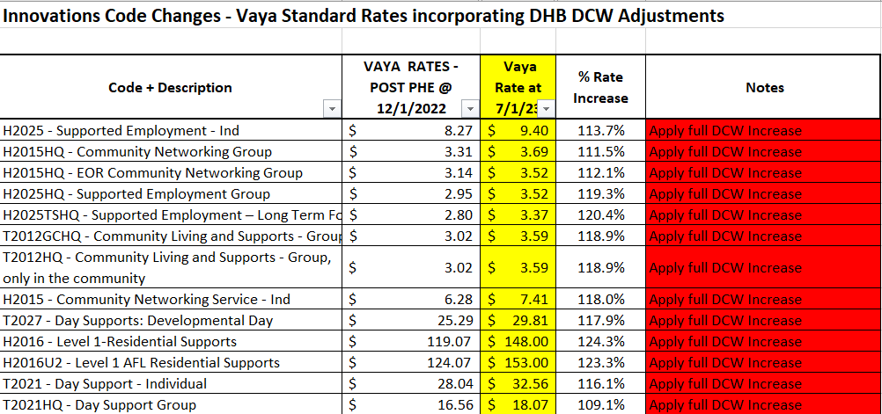
Rate Updates – 1915(c) Innovations
Services for which the full NC DHB DCW Rate Supplement will be added.

Slide 10
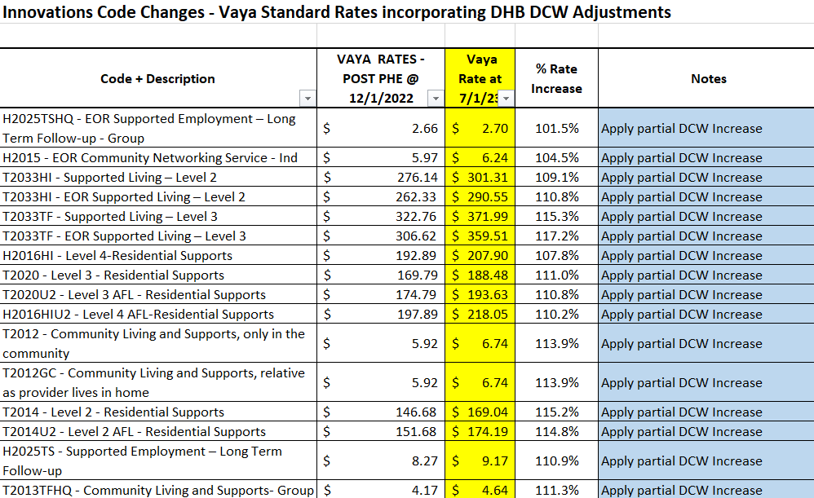
Rate Updates – 1915(c) Innovations
Services for which partial NC DHB DCW Rate Supplement will be added.

Slide 11
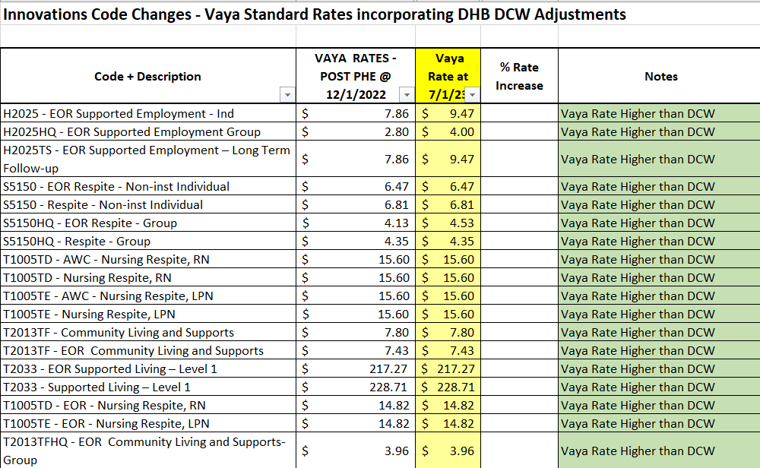
Rate Updates – 1915(c) Innovations
Services with no rate adjustment added due to Vaya’s previous rate being higher.

Slide 12
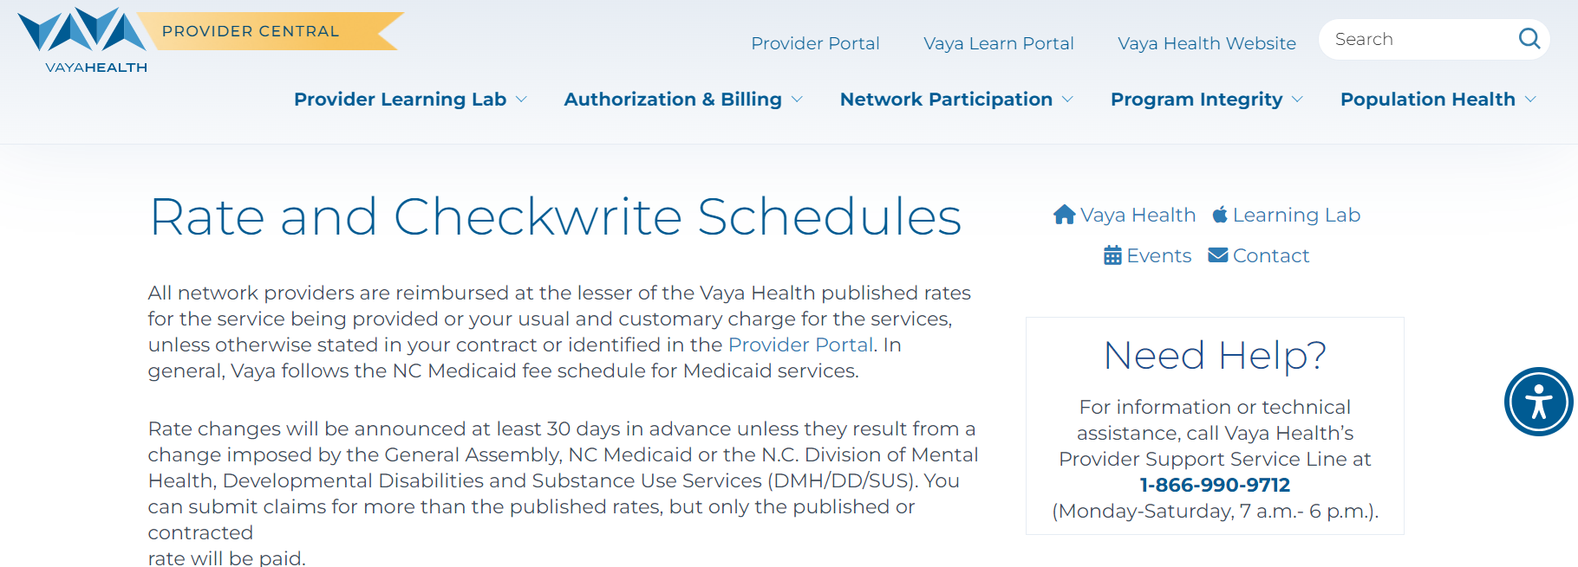
Rate Updates – Posted Rate Schedules
Rate and Checkwrite Schedules | Vaya Health

Slide 13
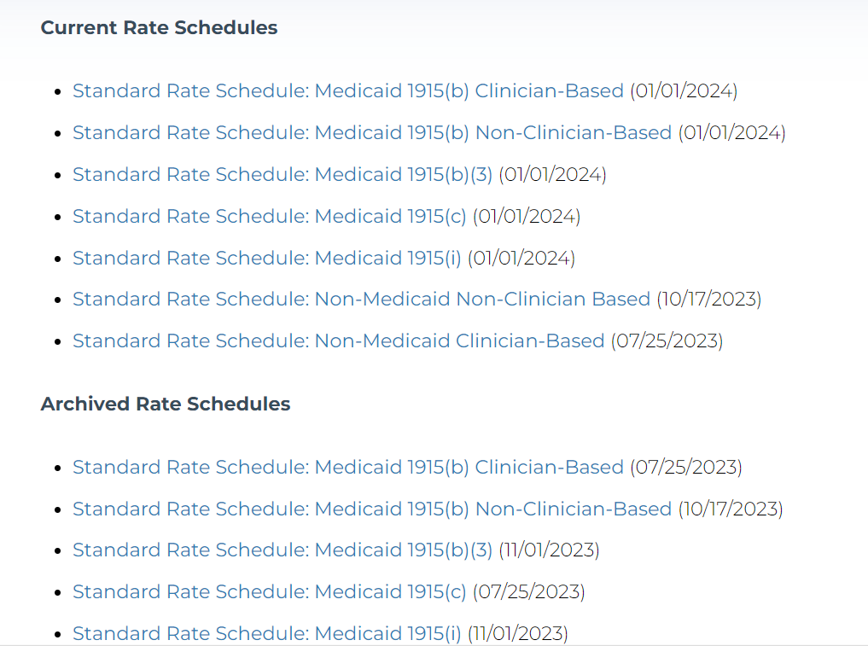
Rate Updates – Posted Rate Schedules
Rate and Checkwrite Schedules | Vaya Health

Slide 14
Rate Updates – New Information
Vaya Claims will be using the functionality of the HSP system to process the Innovations Claims previously paid for the July 1, 2023 to Dec. 31, 2023 date range.
Providers do NOT need to refile any claims previously paid in order to earn the rate increase.
Claims will be paid at the increased rate through an adjusted rate process.
Once the adjustment claims process is completed, details will be available to providers in the standard 835 and Remittance Advice formats.
Providers are encouraged to focus on maximizing the quantity of paid claims from the July 1, 2023 through Dec. 31, 2023 date range, rather than needing to do any refiling of previously paid claims.

Slide 15
Rate Updates – New Information
Forthcoming: Attestation Form.
Providers will be required to execute an Attestation Form that will be provided by Vaya Health that affirms that the provider will be in compliance with the stated aims of NC Division of Health Benefits and of Vaya Health for the Direct Care Worker Rate supplements.
Once finalized, the Attestation Form will be issued to providers. Vaya will communicate a window of time in which the form is to be executed and returned so that the adjustment payments may be processed and issued.

Slide 16
Rate Updates – Summary
Review the Provider Communications Bulletin and updated Vaya Rate Schedule information
To view current rate schedules, visit our Rate and Checkwrite Schedules webpage.
Make changes to your claims and billing systems to ensure that you are billing at a rate at or above the new standard or contract rate.
Once issued, review the Attestation form, execute and return it to Vaya Health as instructed
If you have questions or need assistance, contact your Provider Network contract manager or email provider.info@vayahealth.com.

