Slide 1
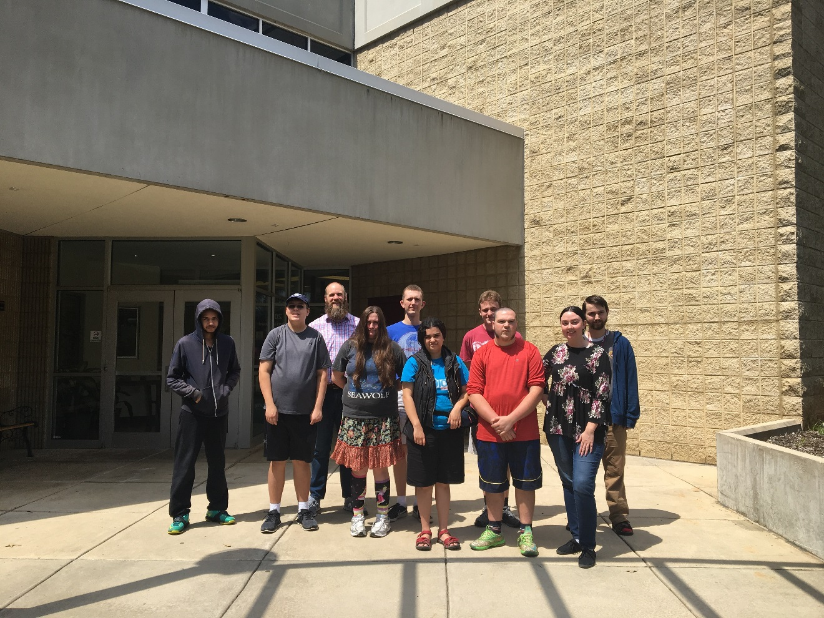
Project SEARCH

Slide 2
Welcome

Slide 3
Partnership

Slide 4
Partnership
Mission Health: on-site classroom, internship sites and mentors
A-B Tech: instruction, curriculum and prospective interns
NC Vocational Rehabilitation: job coaching and support
The Arc of NC: job development and support
Vaya Health MCO: coordination and employment support
NCCDD: Asheville project implementation
Families: bring a new perspective, give valuable feedback to the team, add an additional voice for student selection, and facilitate the Family Involvement Program

Slide 5
Partners in Action
https://www.ednc.org/2018/11/16/bright-spots-project-search/

Slide 6
Project SEARCH
Project SEARCH is a year long internship program that supports young adults with diverse-abilities to:
Find and retain competitive employment
Learn employment skills
Explore different careers
Build confidence
Learn to work as a team
Mature and learn soft skills to help support each person be their BEST SELF.

Slide 7
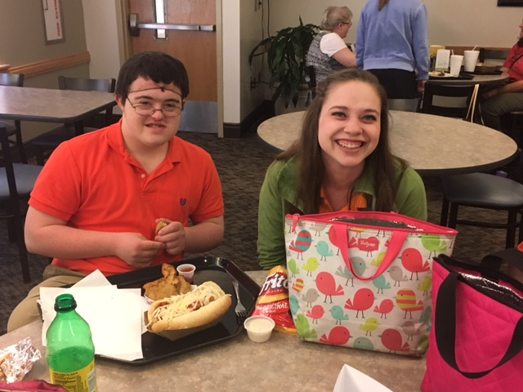
Project SEARCH Programs take place all around the world:
500 programs in 45 states, Canada, England, Ireland and Scotland.
Some Project SEARCH Programs take place at hotels, airports, local governments and many other hospitals.

Slide 8
Example of Project SEARCH year
AUG
JUNE
Begin
1st Internship
2nd Internship
3rd Internship
Graduate & Begin Work at Host Site or in Community
Transition Week
Transition Week
3 week
Boot Camp
Regular Employment Planning Meetings

Slide 9
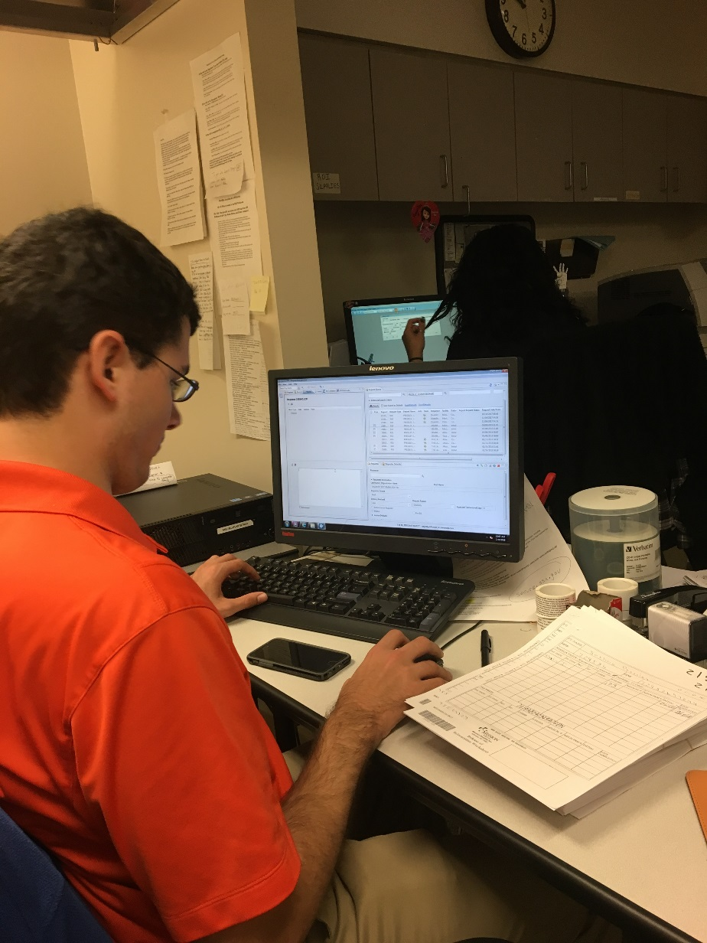
Sample
Project SEARCH Day
8:30am Morning Classroom: Professional Skills Lessons
Brain Exercises
9:30am-2:15pm internship
2:30pm Afternoon Classroom:
Employability Skills curriculum
Etiquette Lessons
3:15pm Program ends

Slide 10
Goals of Classroom Lessons
The classroom is where interns get to learn and work together not only on employment skills but soft skills and etiquette.
Interns get to share successes and challenges of their day.
Interns learn stress and relaxation techniques.
Interns learn about self–care and health.
Interns learn how to become more independent.
Interns learn about self-advocacy and the importance of diversity and celebrating one another’s strengths.
Interns get to practice their public speaking.

Slide 11
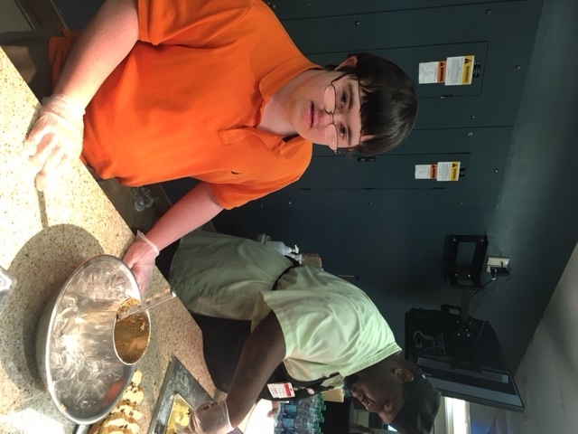
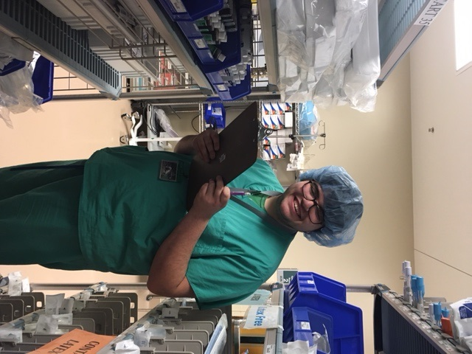
Rotate Through Three Departments
Human Resources
Environmental Services
Chronic Condition
Laundry
Quality & Safety
Child Care
Surgical Services
Sterile Processing
Health Information Management
Guest Services
Food & Nutrition
Gift Shop

Slide 12
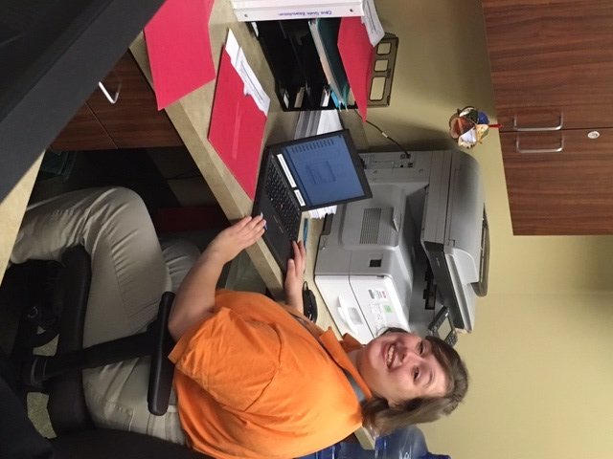
Employability Skills Practiced
CLERICAL SKILLS
TECHNOLOGY
PROFESSIONALISM
CUSTOMER SERVICE
PRODUCTIVITY
WORKPLACE SAFETY
MOTIVATION
INTERVIEW SKILLS
LEADERSHIP AND RESPONSIBILITY
TECHNICAL SKILLS

Slide 13
Direct Impact
http://blog.mission-health.org/2017/12/28/project-search-kylee-story/

Slide 14
Traditional Supported Employment
Job Coach
Task description
Performance expectation
Task conceptualization
Task completion
Task interpretation
Creation of support
Employer
Employee

Slide 15
Compliance to ALLIANCE!

Slide 16
Work Autonomy
A Person-Centered Accommodation Tool

Slide 17
Networking and other program components
Attending professional events like Goodwill BAC Meetings and Chamber after hours.
Job shadowing
Volunteering
Reverse Job Fair
Social Events
Mission Hospital Bake Sale
Attending Job Fairs and other events to learn about employment
Special Events
Mentorship

Slide 18
We Want the World to Look at Our Interns in a Different Way
If we want to change perceptions, we must use
Perception Changing Language
Some examples:
Value vs Charity
Strengths/Weaknesses vs Abilities/Disabilities
Diverse Abilities vs Disabilities
Work vs Jobs
Career vs Jobs

Slide 19
Goal of the Program: COMPETITIVE EMPLOYMENT
After graduations, interns transition into The Arc of NC’s Supported Employment Program
24 out of 26 interns from Project SEARCH have gained employment in the community
(7 interns got hired at the hospital)

Slide 20
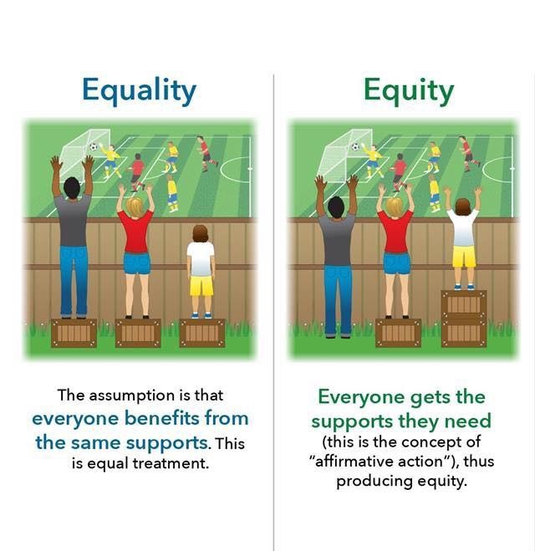
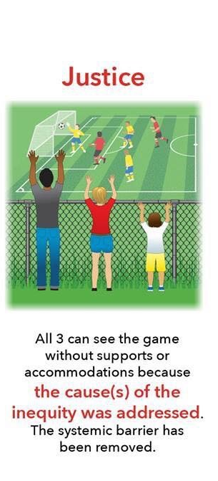

Slide 21
Eligibility Criteria
18-35 years old individuals will receive priority placement
At the time program starts, graduated from high school
Diagnosed with a Developmental or Intellectual disability
Qualify or have VR counselor and Vaya Services
Willingness to be onboarded for Mission Health
Daily reliable transportation to the program
DESIRE TO WORK

Slide 22
If you fit the criteria and are interested…
Pick up an application today (back of the room).
Fill out the Application completely. Submit the Application to Arc of North Carolina by April 9th.
If you complete the application and meet the criteria, we will let you know in April and we will request you join us for Skills Day on May 6th.
Skills Day lets us learn how you work and what supports you may need. Help us to determine how well you work as a team and if you are ready for the program.
Up to 12 interns will participate each year in the Project SEARCH Program

Slide 23
Questions?

