Slide 1
Value Based Care: From Volume to Value
1/15/2020
Andrew D’Onofrio, MPA, SSBB
Network Performance Director
Vaya Health

Slide 2
Outline
Background
Performance Review
Medicaid Transformation VBC Plan
Takeaways

Slide 3
Background
Medicaid Transformation mandates a move to Value Based Care.
“Purchasing health,” and not just healthcare.
“Department aims to rapidly accelerate the use of VBP through Medicaid Managed Care.”
https://files.nc.gov/ncdhhs/VBP_Strategy_Final_20200108.pdf
Health Care Payment Learning and Action Network (HCP-LAN)
Alternative Payment Model (APM) Framework
http://hcp-lan.org/workproducts/apm-framework-onepager.pdf
Notes:
More to come on the framework.

Slide 4
Background
Current Measures
Emergency Department Admits
Follow-up After Discharge from Hospital
Annual Primary Care Physician Visit

Slide 5
Performance Review
.

Slide 6
Performance Review ED Admits
Notes:
Population Health

Slide 7
Performance Review ED Admits

Slide 8
Performance Review ED Admits

Slide 9
Performance Review Follow-up After Discharge

Slide 10
Performance Review Follow-up After Discharge

Slide 11
Performance Review Follow-up After Discharge

Slide 12
Performance Review Primary Care Visits

Slide 13
Performance Review Primary Care Visits

Slide 14
Medicaid Transformation VBC Plan

Slide 15
Medicaid Transformation VBC Plan
Health Care Payment Learning and Action Network (HCP-LAN)
Alternative Payment Model (APM) Framework
http://hcp-lan.org/workproducts/apm-framework-onepager.pdf
http://hcp-lan.org/workproducts/apm-refresh-whitepaper-final.pdf
North Carolina’s Value-Based Payment Strategy for Standard Plans and Providers in Medicaid Managed Care (Draft January 8, 2020)
https://files.nc.gov/ncdhhs/VBP_Strategy_Final_20200108.pdf

Slide 16
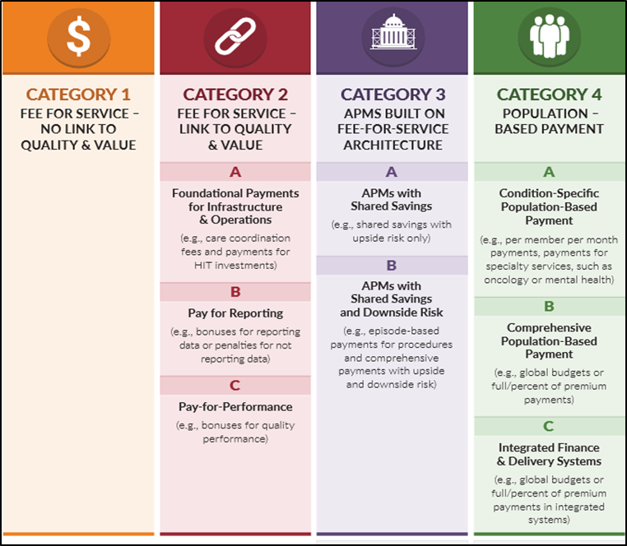
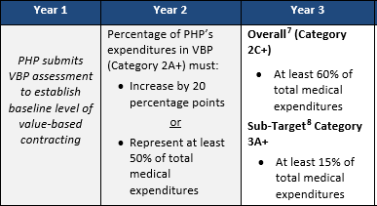
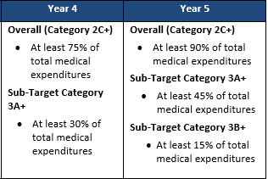
Medicaid Transformation VBC Plan
Notes:
What’s in your future

Slide 17
Medicaid Transformation VBC Plan
Withhold Measures
Prenatal and Postpartum Care (Both Rates)
Cervical Cancer Screening
Live Births Weighing Less than 2,500 Grams
Well-Child Visits in the Third, Fourth, Fifth and Sixth Years of Life
Asthma Medication Ratio (Total Rate)
Medical Assistance with Smoking and Tobacco Use Cessation
Comprehensive Diabetes Care: HbA1c Poor Control (>9.0%)
Follow-Up After Hospitalization for Mental Illness
Initiation and Engagement of Alcohol and Other Drug Dependence Treatment (Both Rates)
FUD from Community Hospitals, State Psychiatric Hospitals, State ADATCs, and Detox/Facility Based Crisis Services for SUD Treatment 1-30 days.
Community MH Inpatient Readmissions within 30 Day
https://files.nc.gov/ncdhhs/documents/PHP-QualityPerformance-and-Accountability_ConceptPaper_FINAL_20180320.pdf

Slide 18
Takeaways

Slide 19
Takeaways
Good Start, more to come.
Paradigm Shift
Will affect most aspects of your organization
Happening fast
Start preparing now
Workflows
Interventions
Who “owns” it?
Find resources
APMs for Behavioral Health
https://www.scattergoodfoundation.org/publication-series-pdf/?series_id=22&post_id=1314&previous=1294

Slide 20
Takeaways
What may come…
APMs for BH
Case rate/bundled rate for SU Disorders (detox, rehab, etc.)
MAT Bundled Payments
Child First Episode Specialty Care
Bundle: Medication, psychotherapy, care coordination, supported employment, etc.
Telehealth Incentives (VA)

Slide 21
Questions?

